Slide 1


Standards for essential and vegetable oils – trade facilitator or barrier?
Elsie Meintjies Global Quality and Standards Programme 15 September 2023

Slide 2
Standards for essential and vegetable oils – trade facilitator or barrier?
Preparing for biotrade industry exports
15th September 2023
Dr Elsie Meintjies
Chief Technical Advisor
Global Quality and Standards Programme
South Africa project (GQSP-SA)

Slide 3
SUPPLY CHAIN
Requirements
Customer requirements
Voluntary standards
Method of checking
Regulatory requirements
SUPPLIER
Producer
Retailer
Stockest
Service Provider
BUYER
Consumer
Trader
Manufacturer
Organisation
Government Agency
PRODUCT OR SERVICE

Slide 4
CONFORMITY ASSESSMENT
VOLUNTARY
Regulated Sector
Government
Customer
Requirements
STANDARDS
Regulatory
CERTIFICATION
Supplier
Buyer
(Customer)
Supplier
Buyer (Customer)
Accreditation/
Recognition
Measurement
Notes:
Certification allows your organic or natural cosmetics to be commercialized worldwide

Slide 5
Standards form the foundation of world trade
Types of standards
Product Standards
Management System Standards (e.g., ISO 9000 etc)
Sector Specific Standards (e.g. medical devices)
Private Standards
Test methods (e.g. used for the physical and chemical profile of a product)
Measurement (e.g. volume, mass etc)
Labelling and prepackaging (a compulsory requirement)
Conformity Assessment Bodies (e.g., inspection, certification, testing, accreditation)
The list goes on ………….

Slide 6
Question: Which standard to use?
Answer: What is the product, who is the customer and where is the destination market?
Regulatory requirements which must be complied with
Standards which define the physical and chemical profile of the product
Additional requirements set by buyer (COSMOS, ECOCERT organic standard, NATRUE, responsible sourcing etc)

Slide 7
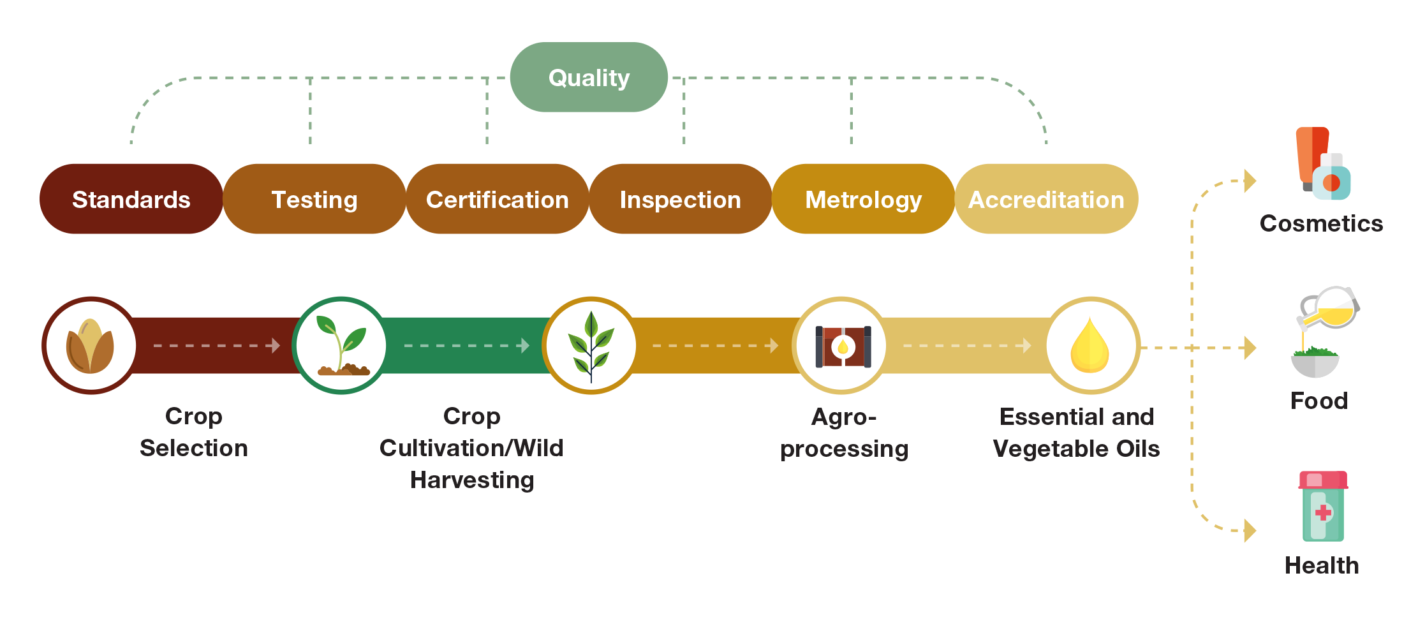
Essential & Vegetable Oils Value Chain
Notes:
The role of standard, quality assurance, accreditation and metrology is evident across the whole value chain from cultivation, wild-harvesting/harvesting, producing the oil, bottling, packaging and transportation.
Although the value chain up to the point of producing the oil looks simple, it is actually quite complex as there are quality control points at each process that need attention in order to produce a consistent quality and quantify of the oil

Slide 8
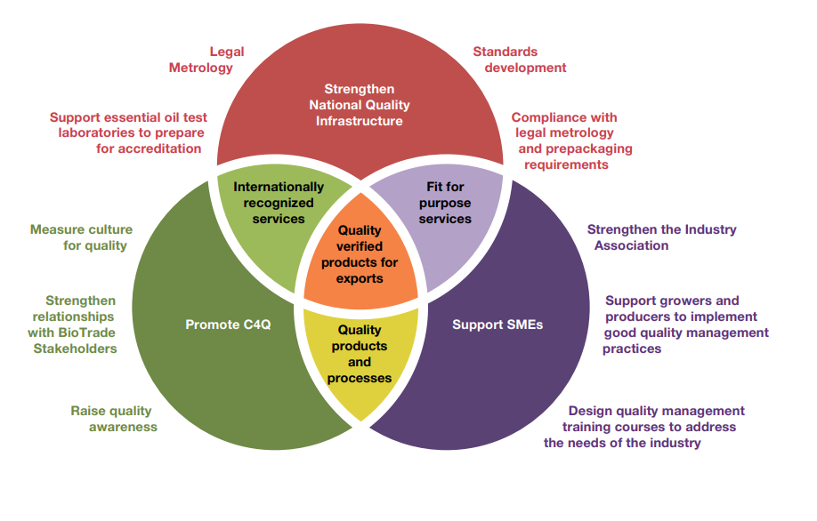
The Ecosystem
Notes:
Project had 3 outcomes (as do all the GQSP projects. The value chains are different in each country.
A systemic approach taken in order to strengthen the industry. It is important to consider the whole ecosystem in a value chain and not just focus on one aspect in order to gain maximum impact.

Slide 9
Breaking into the export market – 2 types of relationships
Reputation/brand (existing with a track record)
Use of conformity assessment (e.g. test certificate, certification)(new entrant)

Slide 10
Thank you for the opportunity and your kind attention
Questions during Q & A session
e.meintjies@unido.org

